Slide 1
Class of 2021
Steps for Seniors
The MASTERS Program
Early College Charter High School

Slide 2
ACT/SAT
1
COVID - OPTIONAL
Sign up and take the October ACT and/or SAT.
College deadlines are approaching fast, and even if you are not sure if or which college, you need to have your options open.
School code is 320-622.

Slide 3
Look for Colleges
2
Look for colleges – trade schools – military/work options
College visits (Most colleges have virtual tours)
Applications – watch deadlines
https://bigfuture.collegeboard.org/college-search
https://ctcl.org/
https://www.princetonreview.com/college-search
https://www.niche.com/
https://www.collegedata.com/en/explore-colleges/college-search/
https://www.mycollegeoptions.org/CollegeSearch
https://www.petersons.com/college-search.aspx
https://www.unigo.com/college-match
https://www.collegexpress.com/college/search/

Slide 4
Apply to College
3
Apply to college
If you don’t apply, you are not going.
Do this as soon as possible.
You do not have to have your ACT or SAT scores to apply.
Money is typically given to student who apply early.
Watch the deadlines and requirements.

Slide 5
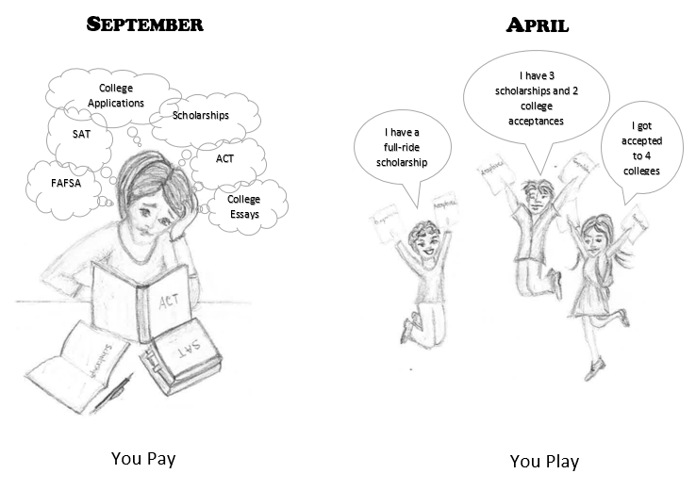
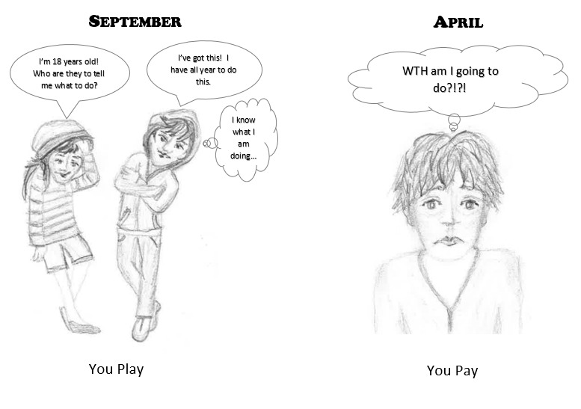

Slide 6
Early Decision/Action
4
Applying early decision or early action program.
Applications are submitted between October and December.
There are benefits of receiving the college’s decision early, usually before January 1st.
Only apply early to a college or university that you would most like to attend.
Many early decision programs are legally binding, requiring you to attend the college or university to which you are applying, should the accept you.

Slide 7
College Essays
5
College essays
Not every college requires them.
You need essays for some scholarships.
Reach out to faculty and staff for assistance.
Do not send your essays without someone else proofreading them.

Slide 8
Resumes
6
Create a professional and strength-based resume
You are going to need one!
Lori can help you.
We have handouts, presentations and expertise to help you.

Slide 9
Letters of Recommendation
7
Letters of Recommendation
Not all colleges and/or scholarships require letters of recommendations.
Make sure to give at least two weeks to a month for your recommenders to write these letters.
There are bottle necks. Meaning that letters of recommendations are due at the same time. Get your requests in early.
Common App requires letters of recommendations. It also requires your school counselor to write a letter.
Give the recommender your resume and sit down with the person to talk about what you would like to see in your letter.
It is not appropriate for your parent to ask your teacher/counselor/administrator for a letter for you.

Slide 10
Financial Aid
8
Financial Aid
This opens up October 1st.
You need your parents help and taxes until you are age 24.
You do this online and both you and your parents need an account
If it asks for money, you are on the wrong website. This is the website: https://studentaid.ed.gov/sa/fafsa
Do this in October as there can be issues with the paperwork and the money goes to the early submissions.

Slide 11
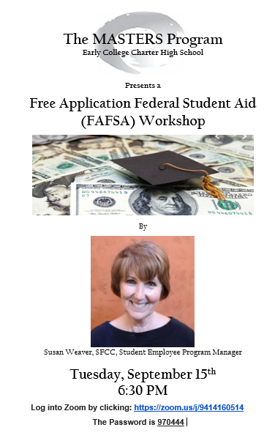

Slide 12
Scholarships
9
Institution
Every college has their own scholarships that can only be used at that college/university.
Private/Agency
www.gocollege.com
www.collegeboard.com
www.collegenet.com
www.fastweb.com
www.google.com
Merit/Need/Trait

Slide 13
Not Sure what to do?
10
Lori
Has assessments and is certified in giving and interpreting them.
Has over 20 years of experience as a career counselor.
Interview/Resume/Cover Letter/Portfolio Workshops.

Slide 14
Transcripts
TMP sends out your high school transcripts.
Repeat after me….
TMP cannot send my college transcripts!
Only SFCC can send out college SFCC transcripts.
You have two separate transcripts from two separate institutions!

Slide 15
One Stop Shop
http://tmpguidance.yolasite.com/

Slide 16
What Else Would You like to Know?

